Slide 1
Spatial models
of infectious disease spread
Steven Riley
(Some material by Neil Ferguson)
Dept. of Infectious Disease Epidemiology
Faculty of Medicine
Imperial College
These slides: https://tinyurl.com/ycd58gbx

Slide 2
Learning objectives
Understand importance of locality to disease transmission dynamics.
Understand the different approaches to spatial modelling (with examples):
  Direct simulation
  Patch models
Understand the utility of spatial models in examining targeted control policies.

Slide 3

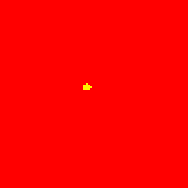
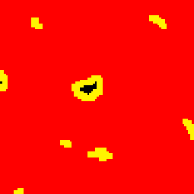
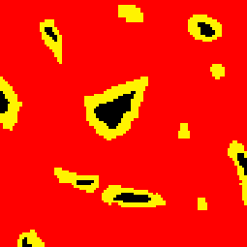
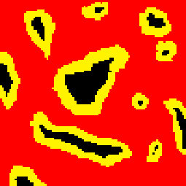
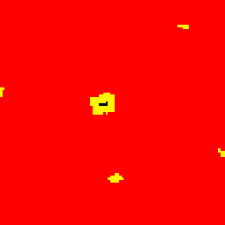
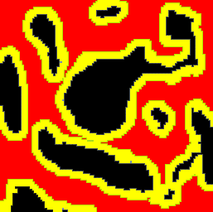
Socio-spatial transmission dynamics
Disease transmission occurs within social & geographic space.
Locality of transmission generates spatial structure
Affects epidemic and endemic dynamics - and persistence.

Slide 4
The importance of locality for disease transmission
Homogenous mixing has got to be wrong.
Key aspects of dynamics & persistence can not be explained without accounting for locality of contacts:
  For childhood diseases, non-spatial models fail to reproduce observed critical community size & intermittency.
  For STIs, the effect of concurrency and partnership duration not captured by simpler models.
  For animals diseases like Foot and Mouth Disease, spread is highly spatially localised.
Most importantly, many reactive control policies (e.g. ring vaccination/culling, area-based controls) are intrinsically local.

Slide 5
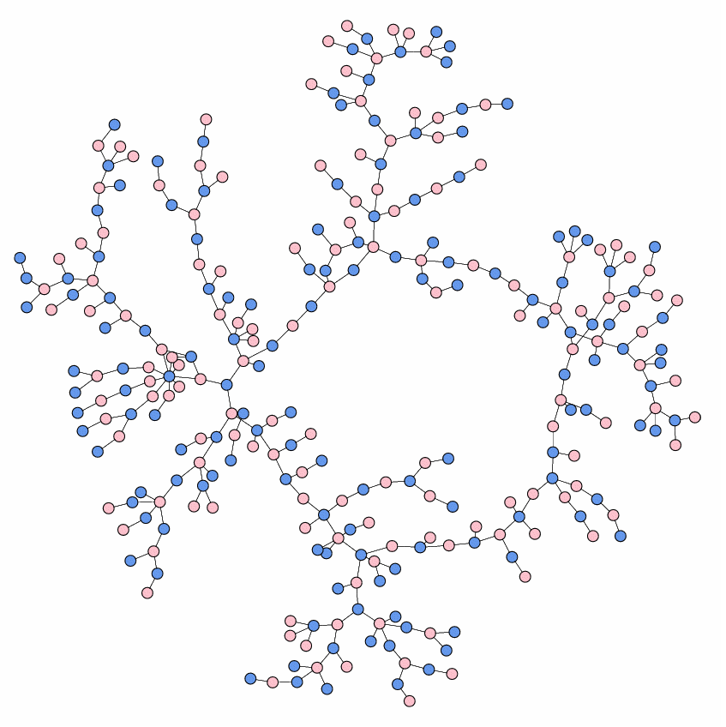
Space & contact networks
What is space in this context?
Both geographic & social elements
Multiple scales - individual
- household
- school/college/workplace
- community (borough/village)
- town/city
- herd/farm/county
- country
Scales have varying importance for different diseases.
New paradigm: transmission occurs on a contact network.
Hard to disentangle network structure (persistent contacts) from spatial structure.

Slide 6

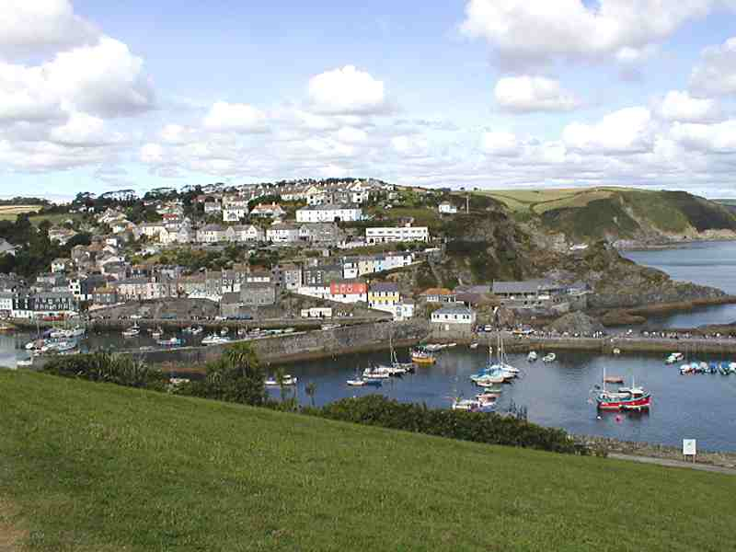
Integrating social and geographic space
Social distance has a geographic element.
Travel in space (or electronic communication) mediates all pairwise social interactions.
Locality in one space predictive of locality in the other.
Critical for spread – social connectedness determines attack rate, and relationship with geographic space determines rate of spatial spread.
Dynamical consequences of the overlap between social and geographic space complex.

Slide 7
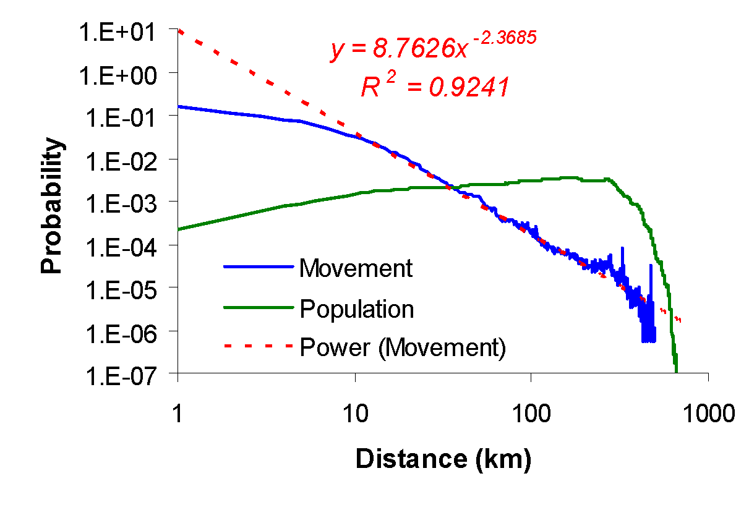
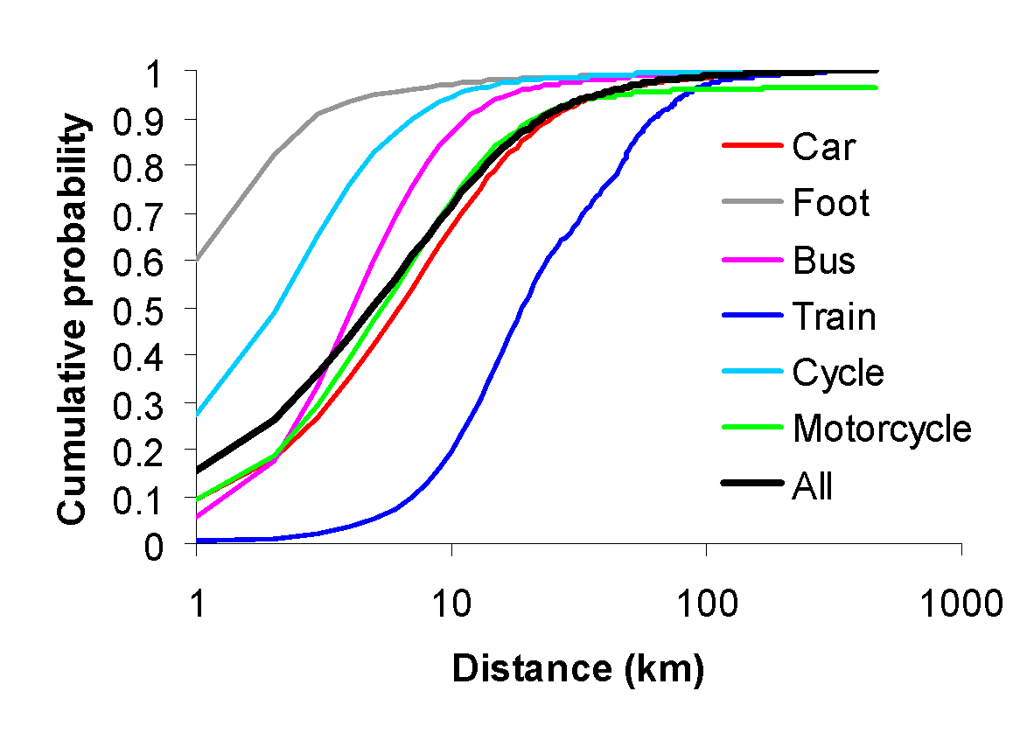
Example: workplace movements
Two of our most important social networks are home and work.
Data indicates most people work close to home.
But distribution is ‘fat-tailed’ – a few people people travel far.
Both the locality of most movements and the few ‘long jumps’ will be important for disease transmission.
‘Scale-free’
behaviour?

Slide 8
Models with spatial kernels
‘Kernel’ = function which determines contact rate as a function of distance = U(r).
Label individuals i=1, … , N, with locations r_{i}
For simple ‘action at a distance’ model, force of infection on individual i is given by:
Here | r_{i} - r_{j} | = distance between i and j.
This model gives higher infection risk in high population density areas.
Models really need to be stochastic – i.e. simulations.
Σ
λ
=
β
U
r
−
⎛
r
⎞
i
⎜
⎟
⎝
i
j
⎠
Probability
∈
{
infected
j
}
Distance

Slide 9
Density dependence
Σ
λ
=
β
U
r
−
⎛
r
⎞
i
⎜
⎟
⎝
i
j
⎠
∈
{
infected
j
}
Above model is density-dependent
  number of contacts (and hence risk of infection) is higher if there are lots of other individuals in the immediate vicinity
  OK for animal diseases.
For human diseases, more realistic to distribute a fixed number of contacts using the kernel – density-independent.
Assumptions about density dependence often not stated in papers.

Slide 10
Diffusion models
Special case of kernel models – assuming local diffusion process (infinitesimal kernel).
Used to be a dominant model choice in ecology and animal/plant disease modelling (e.g. rabies).
Advantage: analytical simplicity (PDE model structure).
But rarely used today – assumption of very local spread is very poor for most real-world diseases.
Also, modelling disease spread using deterministic diffusion models led to the ‘femto-fox’ problem – disease being spread by a spatial wave of unrealistically low infection prevalence.

Slide 11
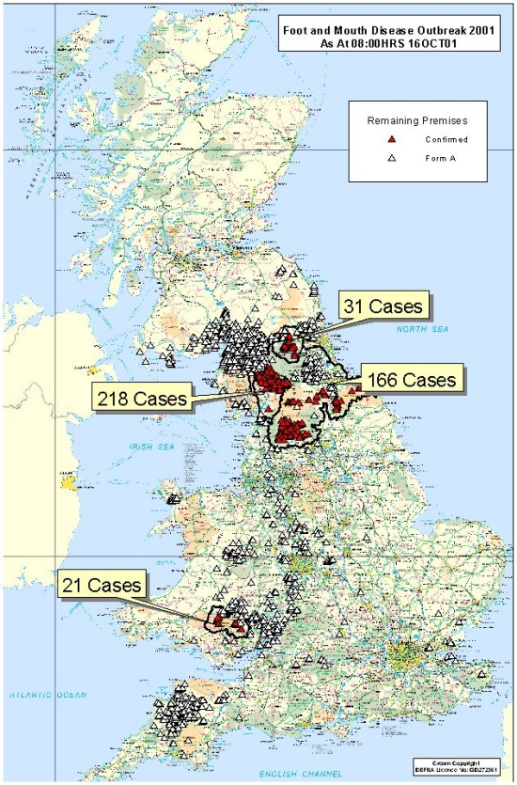
Example: FMD in GB
After initial spread via animal movement, transmission generally local.
0.45
0.4
0.35
Before movement restrictions
0.3
0.25
After movement restrictions
probability
0.2
0.15
0.1
0.05
0
3.5-4
4-4.5
>9
4.5-5
5-5.5
5.5-6
6-6.5
6.5-7
7-7.5
7.5-8
8-8.5
1-1.5
2-2.5
2.5-3
3-3.5
8.5-9
0-0.25
0.75-1
1.5-2
0.25-0.5
0.5-0.75
distance from index case (km)

Slide 12
Model types
Individual-based spatial simulations - capture locality
  can be arbitrarily complex, but computationally intensive
  results can be difficult to interpret.
Patch models (= meta-population) - capture macroscopic patchiness (e.g. at the school/borough/city scale), but ignore micro-scale structure (at individual,neighbourhood level).
  Less computationally intensive
Individual-based network simulations – just another form of individually-based simulation, but explicitly modelling contact networks between individuals.
  Can be difficult to parameterise.
Approximate approaches: moment-closure/pair models
  attempt to incorporate dynamically important aspects of space/networks into simple deterministic models.

Slide 13
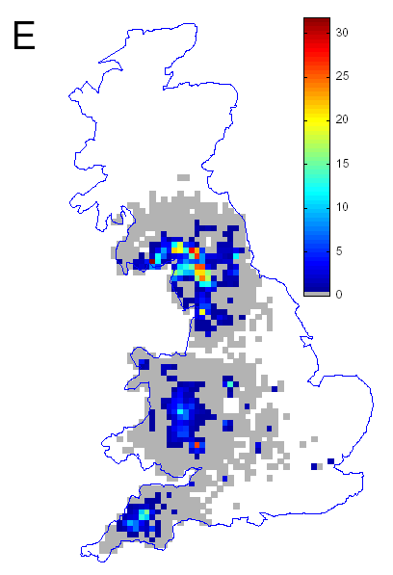
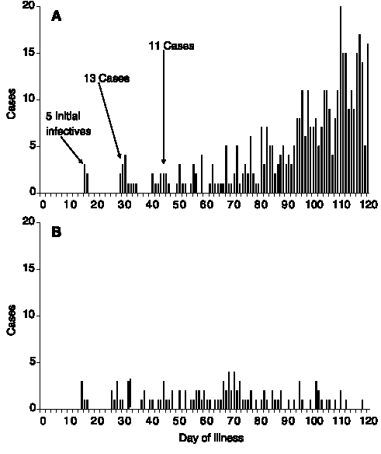
Microsimulations
Build detailed stochastic model of demographics and epidemiological processes affecting population of individuals:
e.g. Simulation of 2001 FMD epidemic (Keeling et al, Science, 2001).
Average of 100 simulations shown.
e.g. Simulation of smallpox in small community (Halloran et al, Science, 2002).
Results with
and without interventions shown, for first 120 days of outbreak.

Slide 14
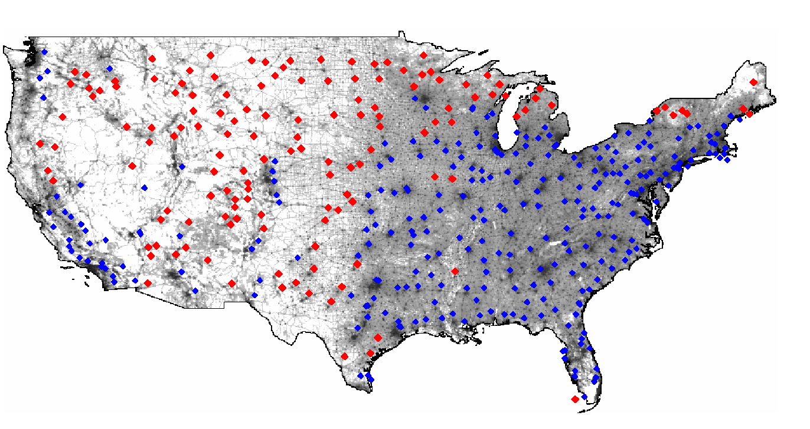
Large scale simulation models
A number of examples of very large scale simulations (60+ million individuals) now developed – mostly to model pandemic flu (but also smallpox).
Models tend to model social structures (e.g. households, schools, workplaces, hospitals, etc.) explicitly, rather than using more abstract network representations.
Models incorporate geographic space explicitly – in distributing the population and in capturing movement patterns.
Ferguson, N.M. et al, Nature 2006

Slide 15
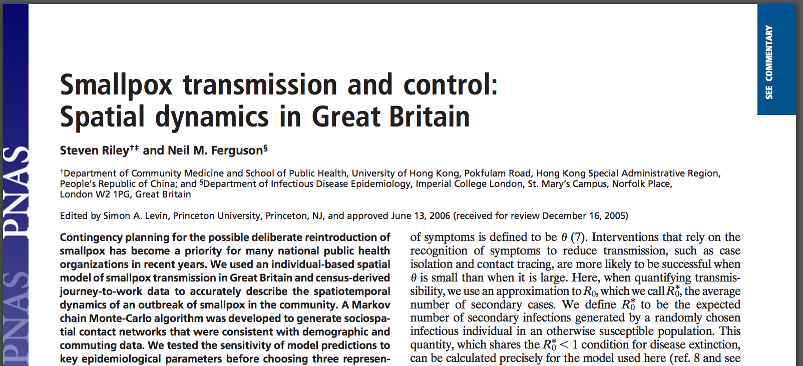
A model of smallpox in the UK
https://www.pnas.org/content/103/33/12637.long

Slide 16
TRANSMISSION BETWEEN INDIVIDUALS CAN
OCCUR IN ONE OF THREE WAYS
Probability
Distance
Household
Network
Spatial
Is this complexity justified?
Household (historical observation and interventions)
Network (spatial spread along “traceable links”)
Spatial (non-saturating, “non-traceable” infections)

Slide 17
THE MCMC UPDATES TEST MANY DIFFERENT WORKER-WORKPLACE ASSIGNMENTS
Accept
Reject

Slide 18
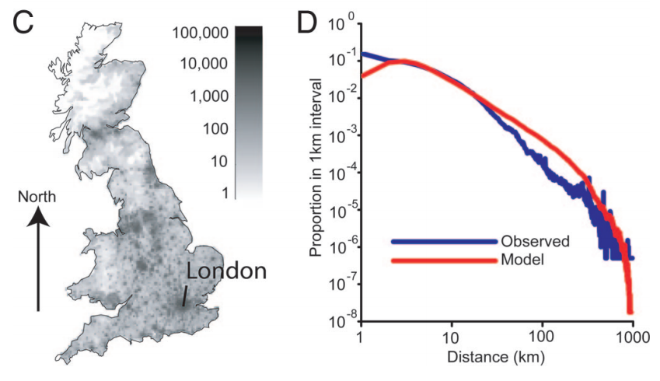
MANY ITERATIONS OF THE MCMC ALGORITHM GIVES A “GOOD” FIT

Slide 19
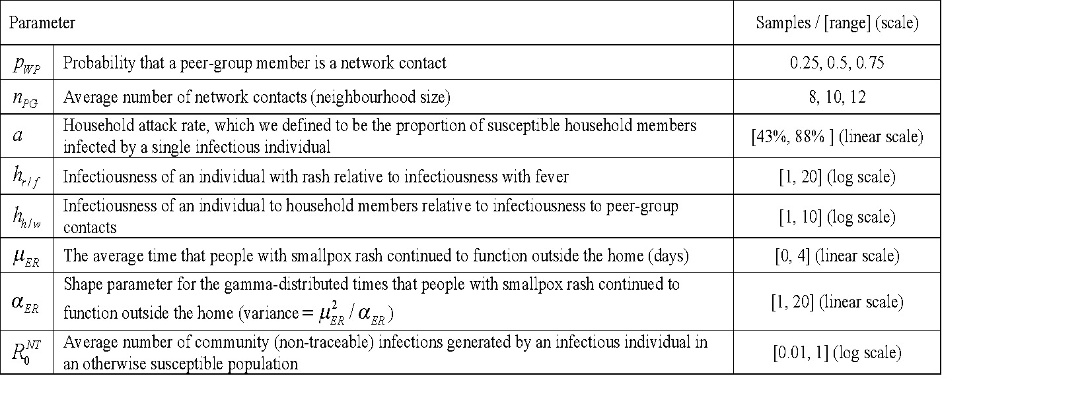
FIRSTLY, WE CONDUCTED A BROAD SWEEP OF PARAMETER SPACE
Stage 1: network setup
Stage 2: parameters which define individual level infectiousness

Slide 20
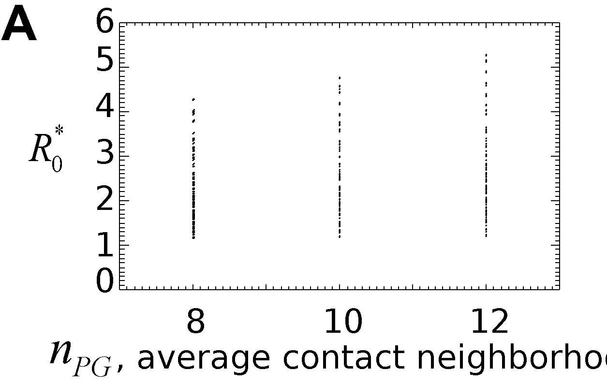
HIGHER VALUES OF R₀* WERE OBTAINED WITH LARGER AVERAGE NETWORK NEIGHBOURHOOD SIZES…

Slide 21
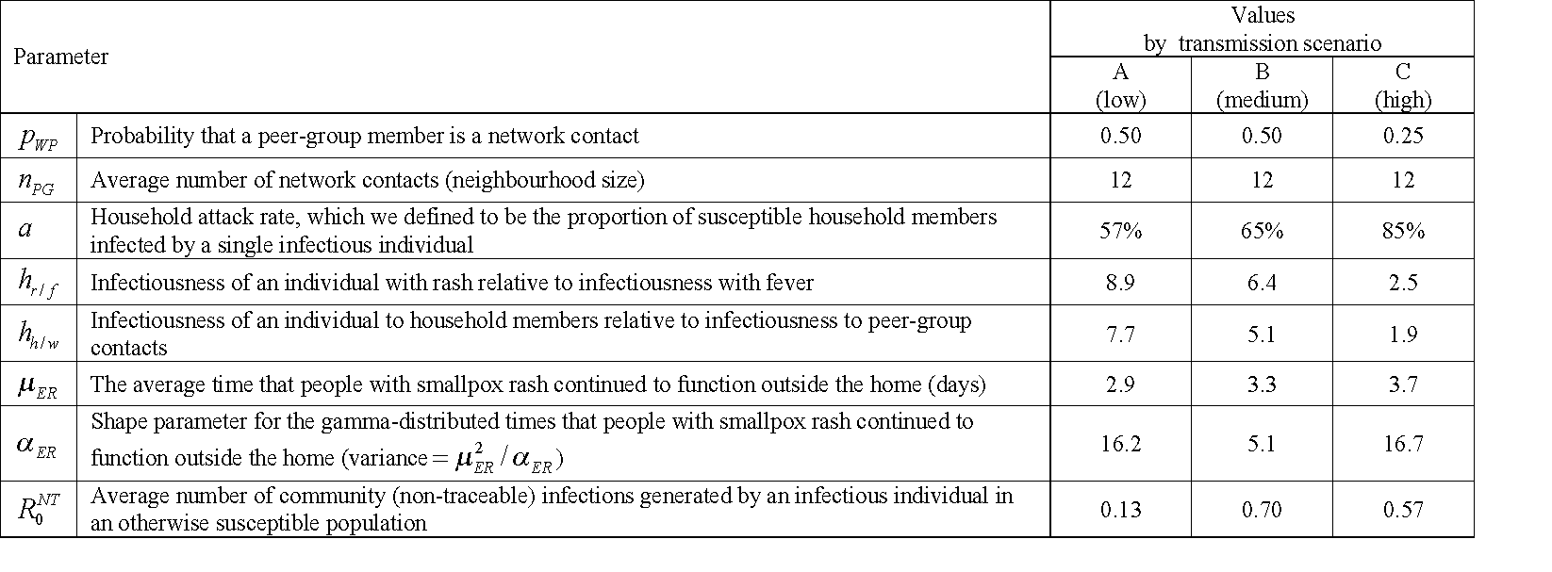
WE SELECTED THREE REPRESENTATIVE SCENARIOS
R_{o}*
θ
1.5
8.7%
2.6
7.0%
5.3
20%
Spatio-temporal dynamics of these
scenarios differ considerably

Slide 22
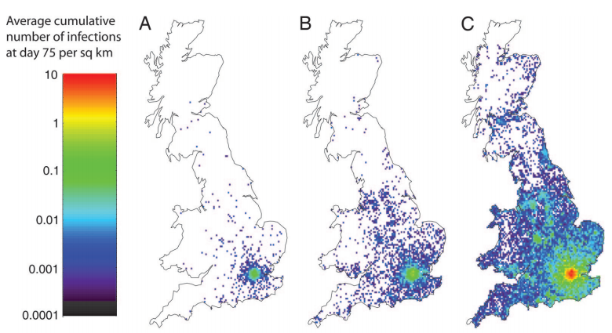
THE SCENARIOS PRODUCE VERY DIFFERENT PREDICTED PATTERNS

Slide 23
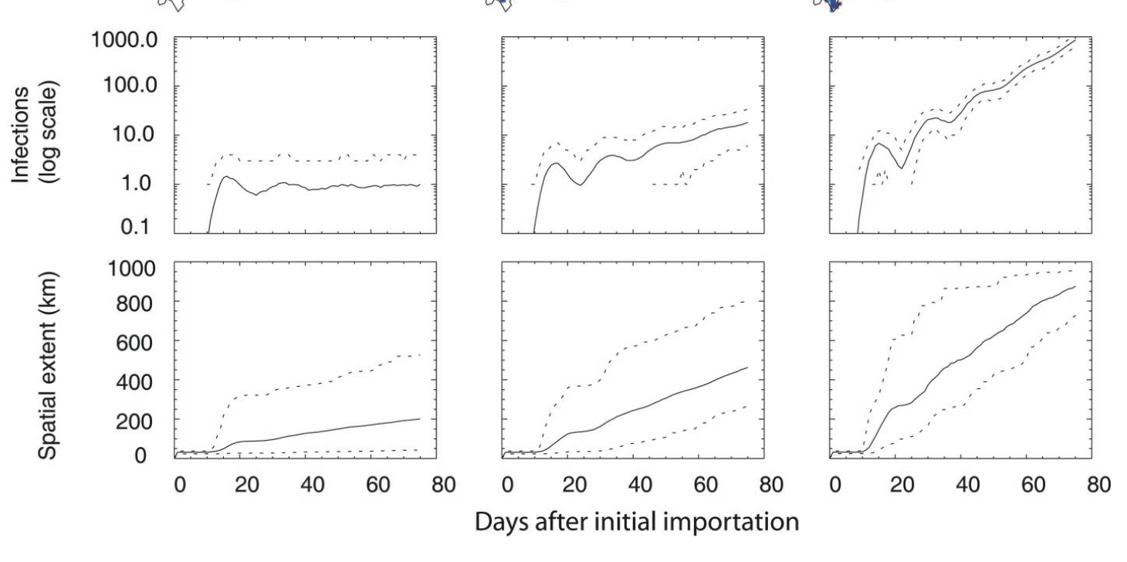
SPATIAL CASE INCIDENCE DATA WOULD ALLOW ACTUAL OUTBREAK TO BE CHARACTERISED QUICKLY

Slide 24
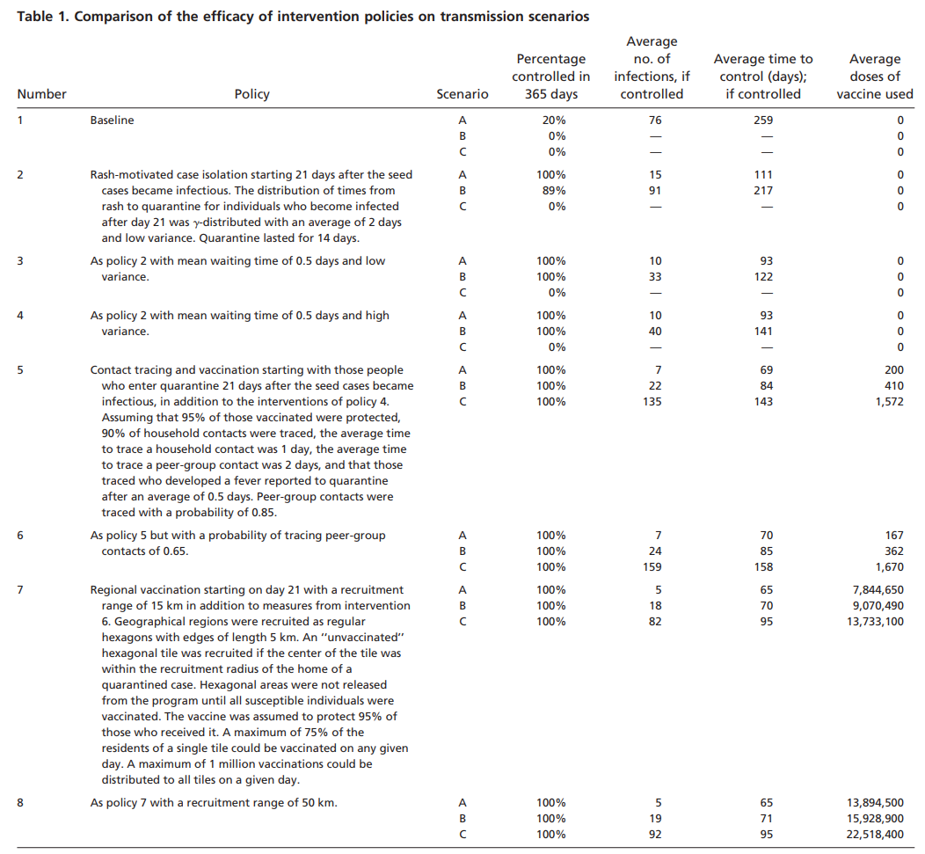
ASSESSING INTERVENTIONS

Slide 25

‘Good’ simulations
Minimal feasible complexity
  just because detail can be included doesn’t mean it should, unless parameters are well-estimated.
Mathematically well-defined, rather than ‘ad hoc’ rules.
Unknown parameters need to be robustly estimated from epidemiological data.
Where data is unavailable, detailed sensitivity analysis needed.
Even if models are only being used to explore dynamics, sensitivity analysis is important to understand mechanisms.
A small minority of published models meet the above criteria - most of the rest are ‘black boxes’ – often of limited use in either understanding disease dynamics or informing control planning.

Slide 26
Conclusions
Accounting for spatially localised spread and social structure essential for detailed prediction of disease spread and effect of controls – particularly targeted control of an outbreak.
Space fundamentally affects the persistence of infectious diseases.
Simulation models increasingly used, but complexity needs to be limited.
Patch (meta-population) models still represent a powerful tool for describing large-scale spread between population centres.
Spatial models much more data-hungry - including demographics/travel patterns.

Slide 27
Learning objectives
Understand importance of locality to disease transmission dynamics.
Understand the different approaches to spatial modelling (with examples):
  Direct simulation
  Patch models
Understand the utility of spatial models in examining targeted control policies.

Slide 28
Unused slides

Slide 29
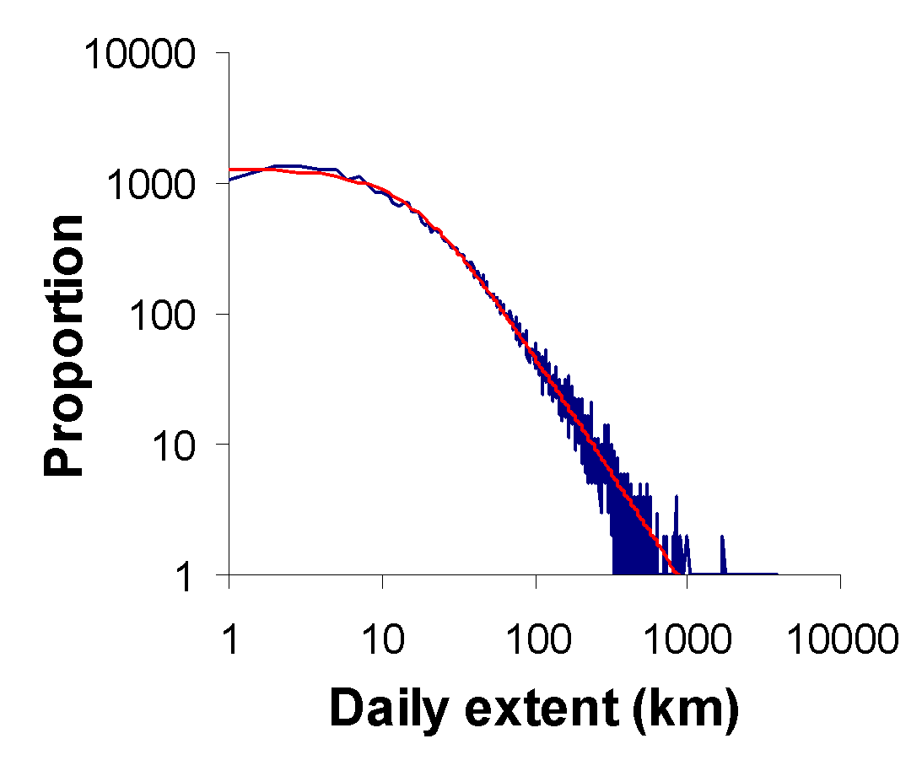
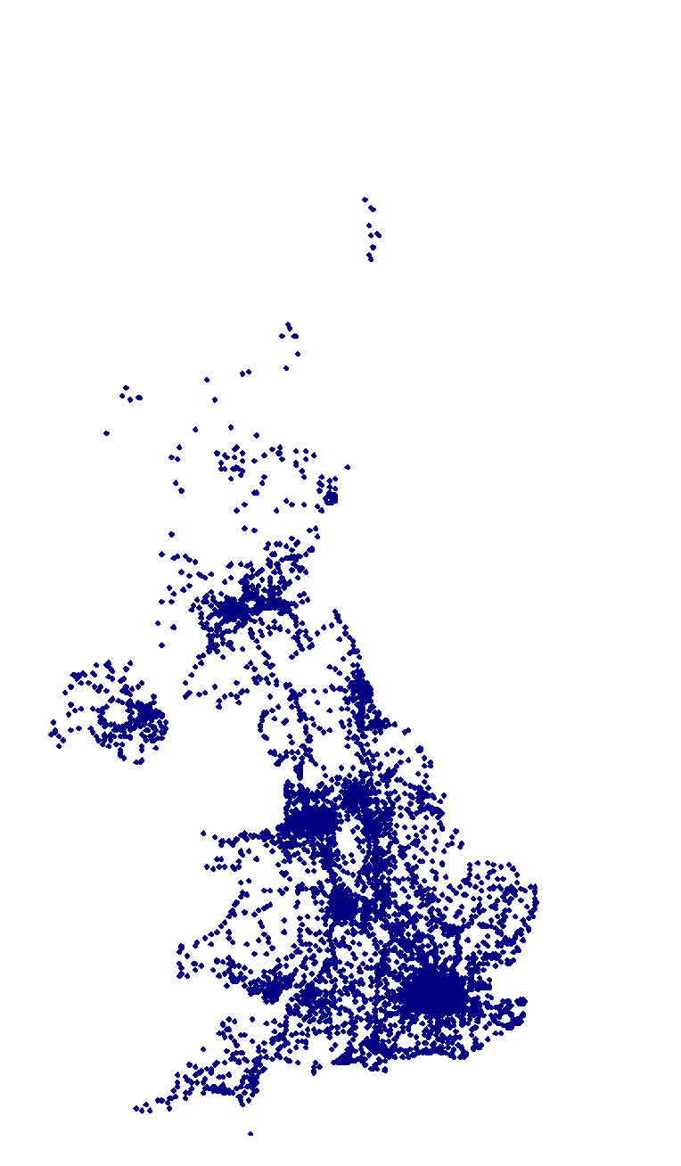
Data is key
Need data on local network structure and dynamics AND on global network structure, relation to geographic space.
Travel/interaction data key to building this new generation of realistic socio-spatial models.
New contacts made, Level 2
3.5
3.0
mean
median
2.5
75th percentile
25th percentile
Mobile
phone
data
number of new contacts
2.0
1.5
1.0
0.5
0.0
1
2
3
4
5
6
7
8
9
10
11
12
13
14
sampling occasions

